Slide 1
Mount Fuji
By: Maisie-Jay Kehoe & Oscar Punch

Slide 2
Mount Fuji is an active stratovolcano. A stratovolcano also known as a composite volcano, is a conical volcano built up by many layers (strata) of hardened lava, tephra, pumice, and volcanic ash. They are one of the most common volcanoes. Stratovolcanoes are characterized by a steep profile and periodic explosive and effusive eruptions. The lava flowing from stratovolcanoes usually cools and hardens before spreading far due to high viscosity (the property of a fluid that resists the force tending to cause the fluid to flow). Stratovolcanoes are common at subduction zones, forming where oceanic crust is drawn under continental. Mt Fuji is located at the triple junction of the Amurian Plate, the Okhotsk plate, and the Philippine Sea Plate.

Slide 3
Stratovolcano

Slide 5
The most recent eruption of Mt Fuji was in 1707. The eruption is believed to have been triggered by an earthquake in the area. This is very rare and doesn't often happen, which makes the eruption very interesting. The eruption ejected tons of tephra (rock fragments and particles) into the atmosphere. 800 Million cubic metres of ash was released from the eruption. The tephra was so thick that residents of the city of Edo (now Tokyo), more than 100 kilometers away, had to use candles in the middle of the day. Although there were no direct fatalities because of the eruption and no lava flow many homes were destroyed and there were some recordings of starvation because the ash from the eruption ruined crops and covered farm lands.

Slide 6
Geologist have identified four seperate phases of volcanic activity in the formation of Mt. Fuji. The first phase, called Sen-komitake, is made of an andesite core recently discovered deep within the mountain. Sen-komitake was followed by the "Komitake Fuji," a basalt layer believed to be formed several hundred thousand years ago. Approximately 100,000 years ago, "Old Fuji" was formed over the top of Komitake Fuji. The modern, "New Fuji" is believed to have formed over the top of Old Fuji around 10,000 years ago. Mount Fuji is made of andesite rock with some basalt under the layers.

Slide 7
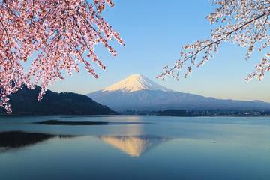
Japan’s Mt. Fuji is an active volcano about 100 kilometers southwest of Tokyo. Commonly called “Fuji-san,” it’s the country’s tallest peak, at 3,776 meters. A pilgrimage site for centuries, it’s considered one of Japan’s 3 sacred mountains, and summit hikes remain a popular activity.

Slide 8
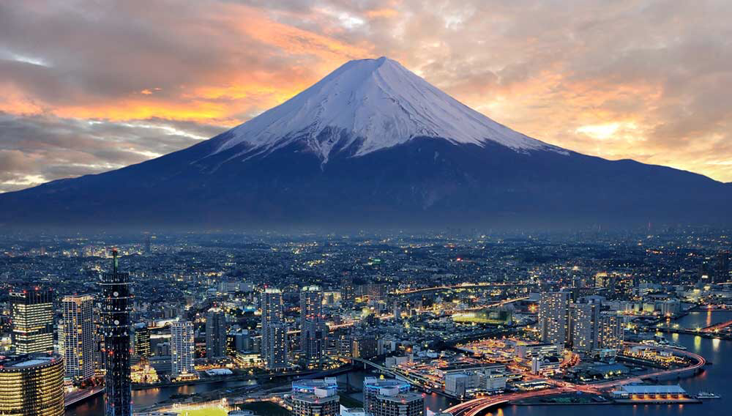
Mt. Fugi is located near the Pacific coast of Honshu, just west of Tokyo.
Four small cities surround it :
Gotemba to the east
Fujiyoshida to the North
Fujinomiya to the southwest
&a Fuji to the east

Slide 9
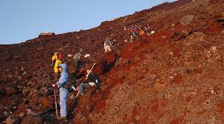
First Ascend to climb was in 663AD by a Monk who’s name is unknown
Climate Tundra
Mount Fuji has 8 peeks
Mount Fugi is the most climbed mountain in the world
200,000 climb every year

