Slide 1
Notre présentation est sur le Luxembourg. nous changeons le Luxembourg comme nous voulions en savoir plus sur l'un des plus petits pays du monde. Premier Oscar présentera la Géographie du Luxembourg et c'est de la nourriture. Suivant Jorge va nous montrer les traditions du Luxembourg. Will présentera ensuite ses diapositives sur l'histoire du Luxembourg. Finalement Jake termine la présentation avec des sports.

Slide 2

Luxembourg
By Oscar, Will, Jake and Jorge

Slide 3
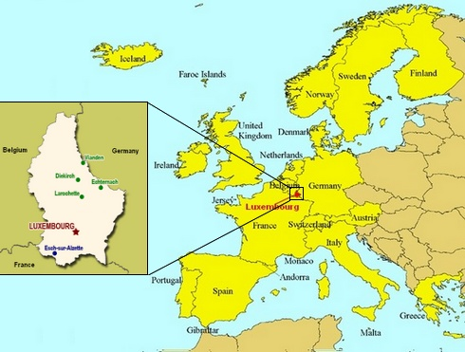
Geography
•Luxembourg is a located in Central Europe.
•It borders Belgium to the west and north, France to the south, and Germany to the east. Luxembourg is landlocked.
•Luxembourg has an area of 2,586 km², it’s about the same size as County Wicklow.

Slide 4
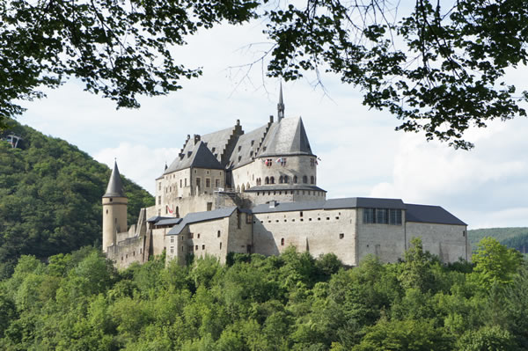
Geography
•Luxembourg has a population of about 600,000.
•Luxembourg is mostly rural, with nature parks and dense Ardennes forest in the north, rocky gorges in the east and the Moselle river in the south-east.
•The capital is Luxembourg City, an old medieval city built on deep gorges cut by the Alzette and Pétrusse rivers.

Slide 5
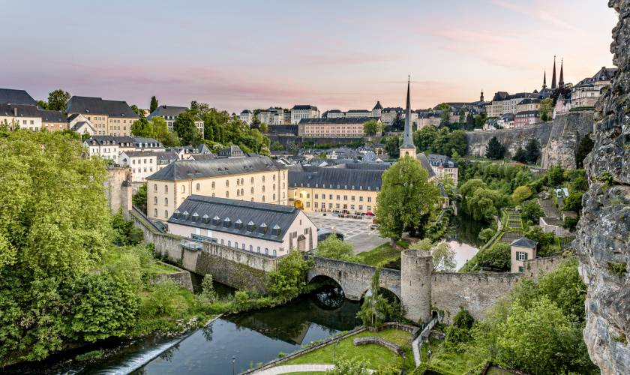
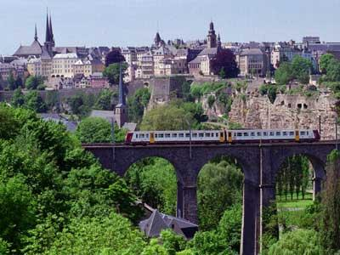
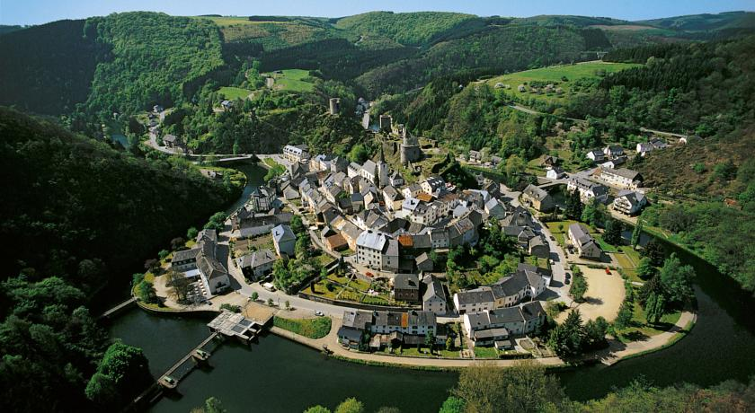

Slide 6
https://youtu.be/_iS6tqc6mTM

Slide 7
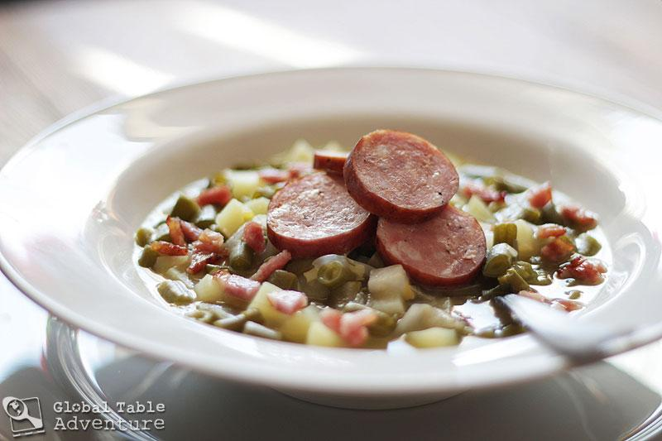
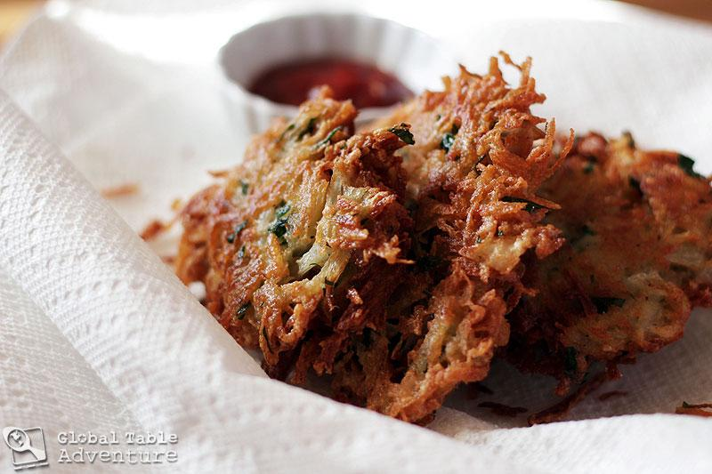
Food
‌• Many of Luxembourg’s traditional foods show the Grand Duchy’s farming heritage as well as its location between Germany, France and Belgium.
‌• Luxembourg's cuisine is also international because of the many foreign influences the country has had.
‌• Luxembourgish food is characterised by large portions, lots of meat, fish, potatoes, beans, cooked with cream and wine.

Slide 8
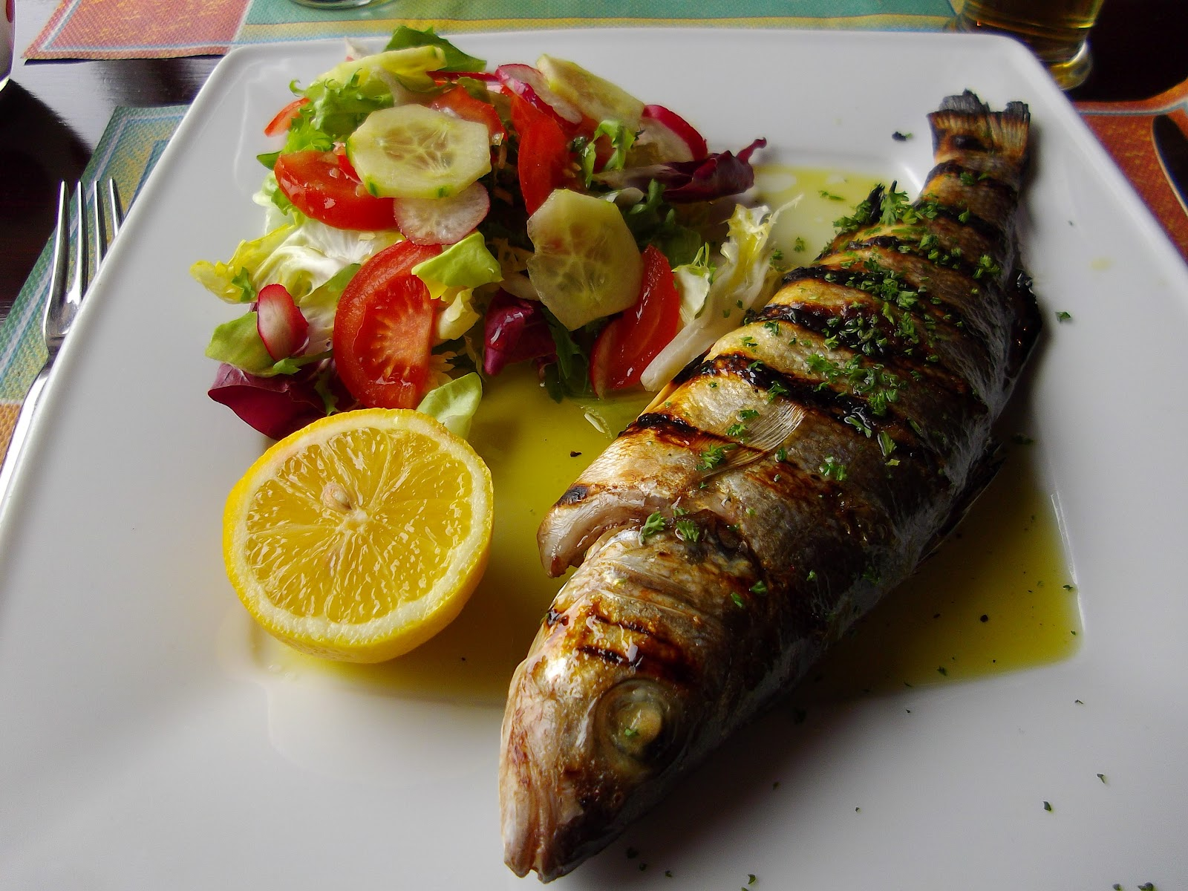
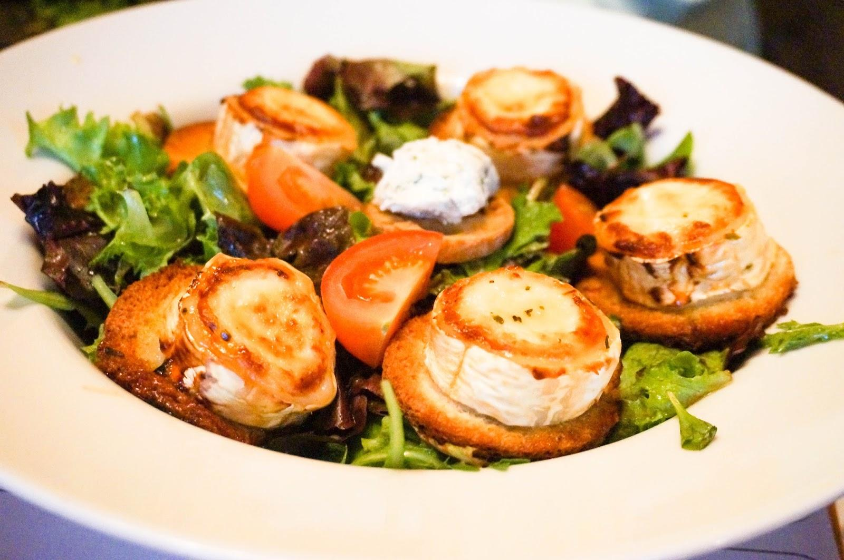
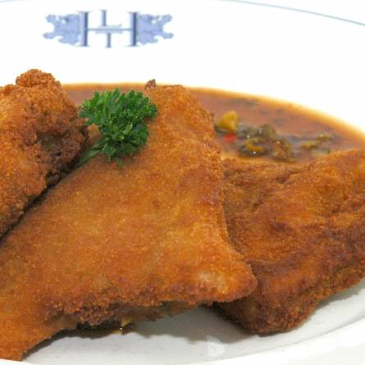

Slide 9
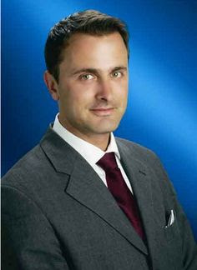
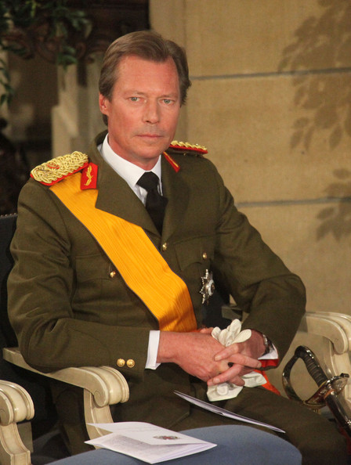
Politics
•Luxembourg is a democracy in the form of a constitutional monarchy, like the United Kingdom.
•The Prime Minister is Xavier Bettel.
•Henri is the Grand Duke of Luxembourg.
•Luxembourg is in the European Union.

Slide 10
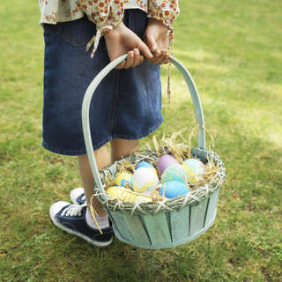
Traditions
-One of the most importants traditions of Luxembourg is the Easter. Every year they make more than 1.000.000 of Easter eggs that means that every person have 2 Easter eggs every Easter monday.

Slide 11
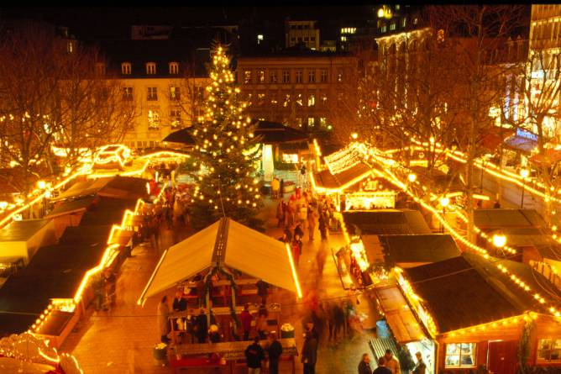
Traditions
-In Luxembourg, the majority of the population are Catholic. To celebrate Christmas, practising Christians attend mass either midnight mass on 24 December, or Christmas mass on 25 December. A particularly beautiful midnight mass is celebrated every year in Notre-Dame. For practical reasons, mass is also celebrated in the early evening on 24 December.

Slide 12
Traditions
-The Luxembourg Festival or the Wiltz Festival, the nights of classical music at the Luxembourg Philharmonic or the International Festival of Echternach are some manifestations in which the capacity of the artists can be appreciated, in addition, it is possible that anyone who wishes to express himself can do it in almost any of these scenarios, especially in open festivals. As far as the musical point of view, rock, pop or indie are very successful. In outdoor festivals you can give an account of the variety of music that is presented in Luxembourg.

Slide 13
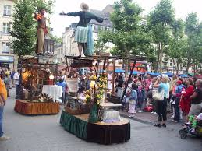
Traditions
Summer in the City: Annual event in the city of Luxembourg during the months of June, July, August and September. The program includes street theater, open air cinema, markets, exhibitions and concerts.
And everything for free because the goberment of luxemburg pay for the tourist
can have fun in the summer.

Slide 14
History
By Will

Slide 15
History
Luxembourg was established as an independent country on the 9th of June 1815. The original size of Luxembourg is over twice the size. Over the years Luxembourg lost land in order to gain independence from its various ruling empires. It first lost land in 1659 to France. It also lost land to what was Prussia in 1815 and again to Belgium in 1839

Slide 16
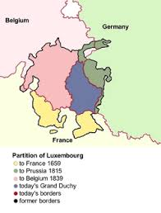

Slide 17
Luxembourg properly began with the construction of Luxembourg Castle in the High Middle Ages. It was built by Siegfried I, the count of Ardennes who traded some of his land with the monks at the Abbey of St. Maximin in Trier in 963 for an ancient, Roman, fort named Lucilinburhuc.

Slide 18
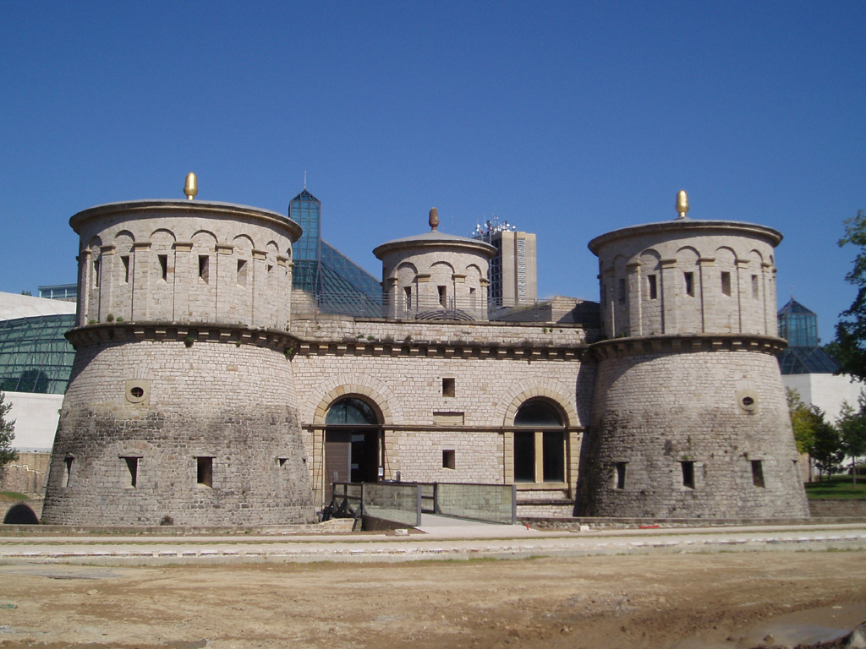
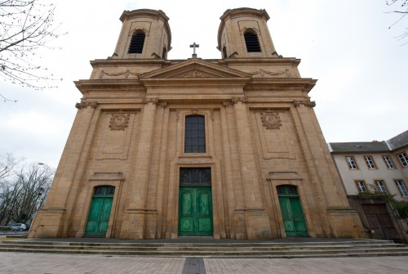
Lucilinburhuc Fort St Maximin Abbey

Slide 19
Sport
Luxembourg play many other sports as well as football as their country does not have a recognised national sport. They only have 460,000 people in their country and still have many athletes in sports such as tennis, running and cycling.
Most famous Luxembourgish sports people:
Nicolas Frantz - cyclist
Gilles Müller - tennis player
Josy Barthel - runner

Slide 20
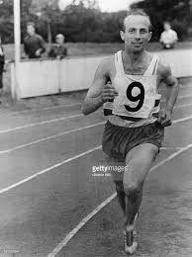

Slide 21
Football
Football is the most popular sport in Luxembourg. The top-flight National division is the premier league in the country. Luxembourg was one of the first countries in the world to be introduced to football, with the National Division being established in 1913, and the national team playing its first match in 1911.
The game is more popular in the south of the country, having grown in popularity in the red lands and Luxembourg city. Only once has the National Division been won by a team not from the south of the country. The most famous footballer at the minute in Luxembourg is Jeff Strasser

Slide 22
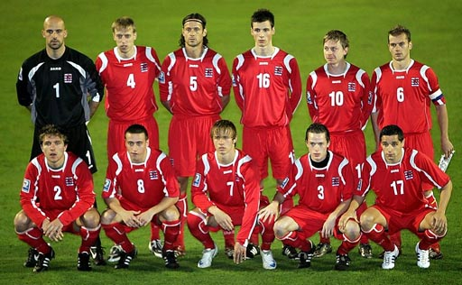

Slide 23
Tennis
Tennis is a popular sport in Luxembourg as it is across western Europe. There are 53 tennis clubs in the country and the oldest one tc Diekirch was founded in 1902. The governing body is the Luxembourg tennis federation. The Fortis championships Luxembourg are held in Luxembourg each year, and are ranked as a tier 3 tournament on the wrap tour.
Luxembourgers aren't very good at professional level tennis. Gilles müller is considered the best men's player the country has ever had he reached the quarter-finals of the 2008 U.S. Open and is ranked at 26th in the world. Women's players that have reached the top fifty include Anne Kremer(18th) and Claudine Schaul (41st). The Luxembourg Davis cup team competes in Group II. The Luxembourg fed cup team competes in Group I.

Slide 24
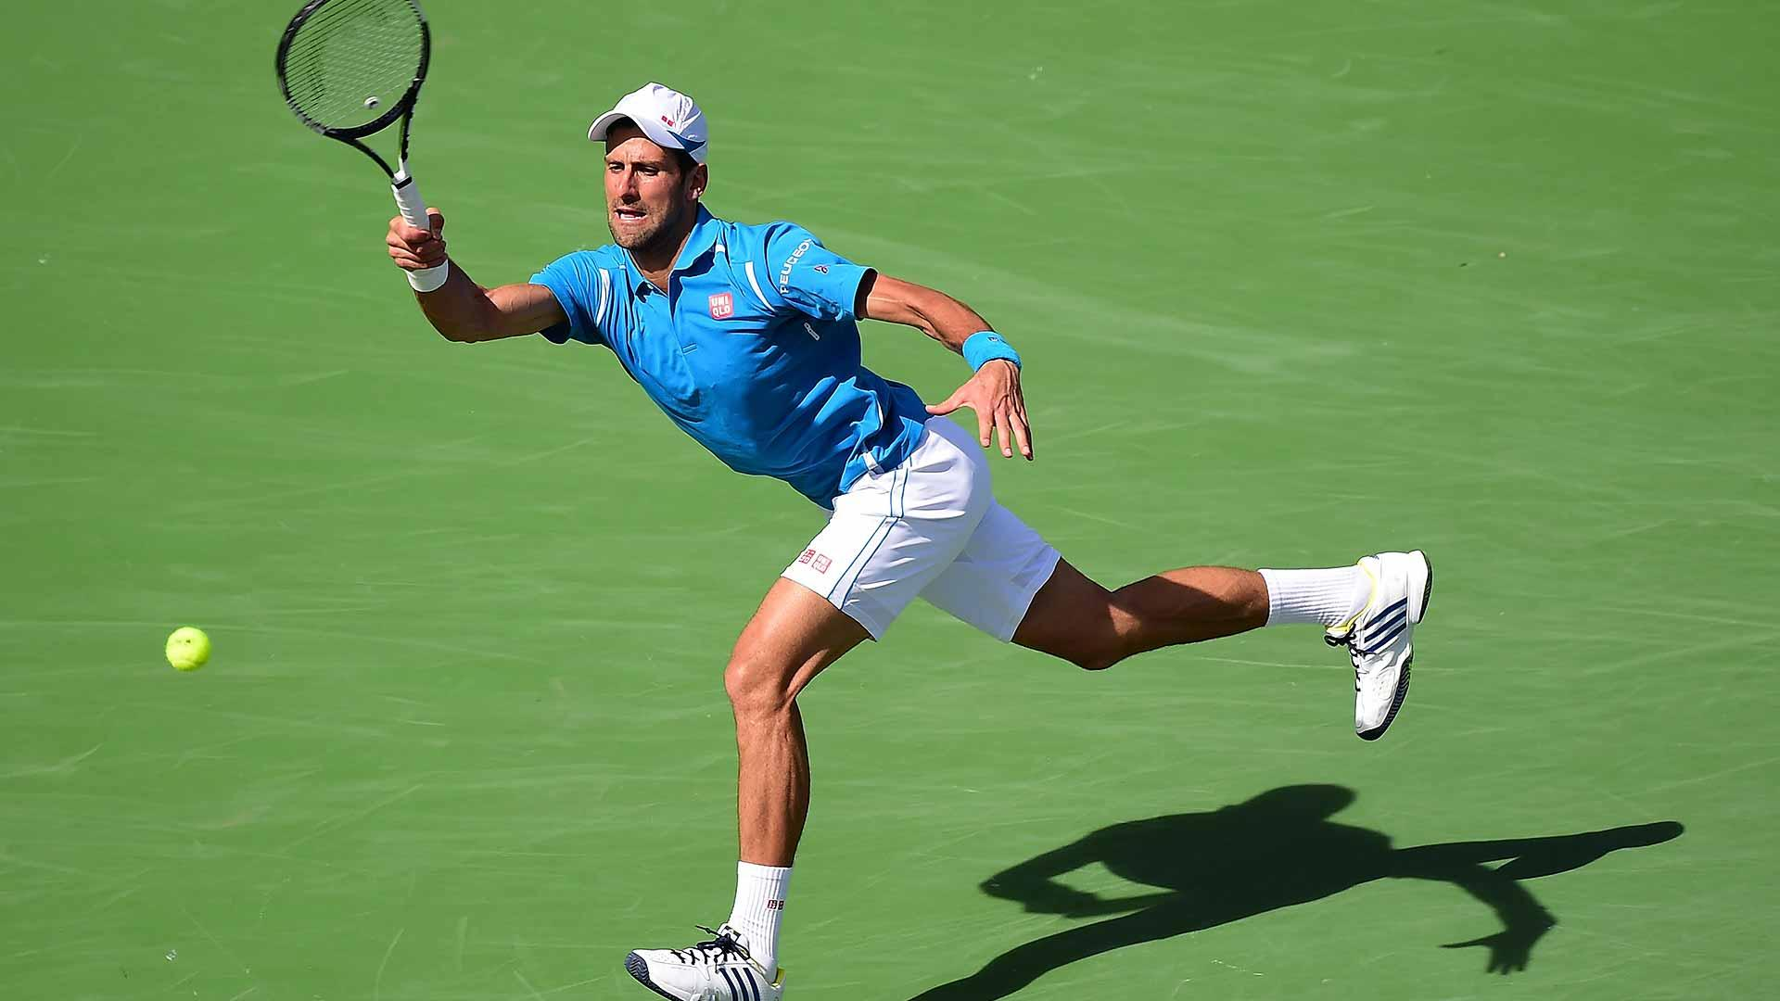

Slide 25
Nous espérons que vous avez apprécié notre présentation et appris autant que nous avons fait sur ce pays incroyable.

